Slide 1
Training DNNs with up to 5x less memory via optimal tensor rematerialization
To appear at:
MLSys 2020
Paras Jain
Joint work with: Ajay Jain, Ani Nrusimha, Amir Gholami,
Pieter Abbeel, Kurt Keutzer, Ion Stoica, Joseph Gonzalez
Notes:
Hi everyone, I’m Paras. Today, I will be presenting Checkmate, a system for training large deep neural networks with up to 5x less memory than current approaches. This work will appear at the Conference on Machine Learning and Systems in March.

Slide 2
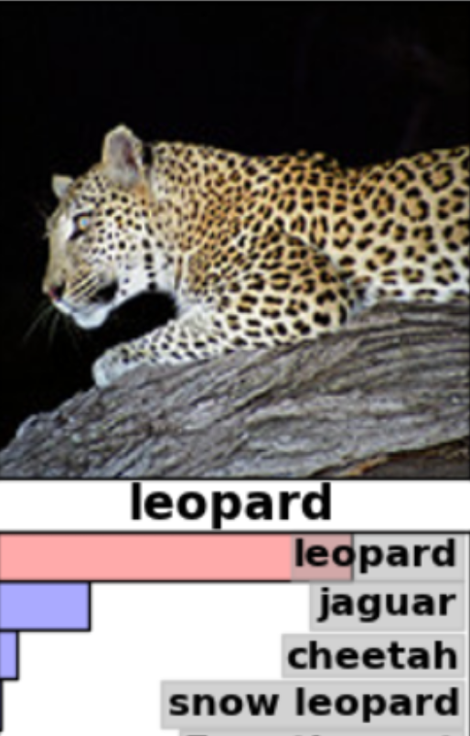
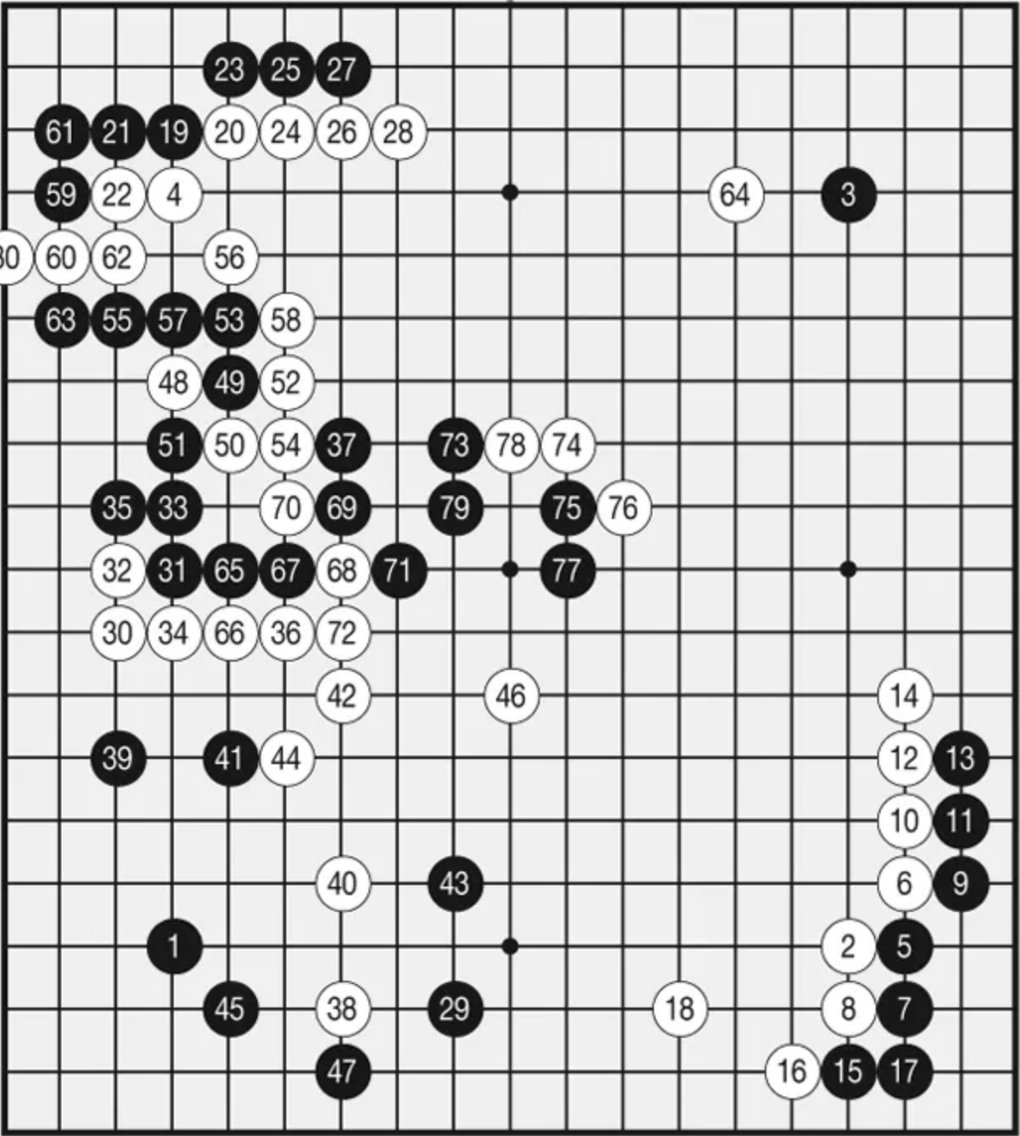
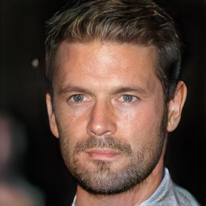
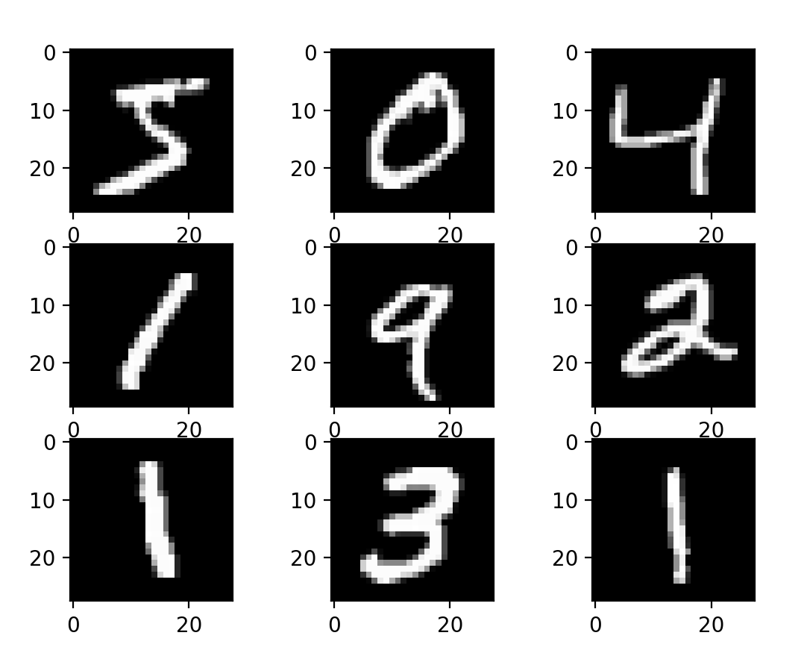
Deep learning continues to adapt to increasing complex applications.
Handwriting
classification
Image
classification
Reinforcement learning
Image
generation
LeCun et al. 1998
Krizhevsky et al. 2012
Silver et al. 2016
Karras et al. 2018
Notes:
Deep learning continues to adapt to increasingly complex applications and domains. From humble beginnings in handwriting recognition, the field has rapidly advanced to addressing problems like image classification, reinforcement learning and most recently high-fidelity image generation.

Slide 3
Parameter count (10⁹)
New applications drove 330x growth in model size
Figure adapted from NVIDIA
Notes:
This rapid progress in applications has led to a dramatic increase in model size. In just four years, state-of-the-art models have grown by 330x. We believe this trend will only continue.

Slide 4
TOPS
per chip
Compute has been a key enabler for big models:
60x faster accelerators
But…
Z
Notes:
Model growth has been enabled, in part, by improvements in deep learning accelerators. In just five years, accelerators have become 60x faster. However, memory is becoming relatively more important than compute during training.

Slide 5
At a per-GPU level, recent state-of-the-art models have hit a memory capacity wall.
RAM usage
per-GPU
Limited GPU memory is slowing progress in new deep learning models!
Notes:
If we zoom in on a single GPU, we see that memory is a key limiting factor. As models continue to grow, they are encroaching on the memory capacity limits of GPUs today. Worryingly, researchers cite limited memory as a reason for making architectural compromises. Limits in GPU memory are slowing progress in the state-of-the-art in model training.

Slide 6
How do we train models both efficiently
and beyond memory limits?
At a per-GPU level, recent state-of-the-art models have hit a memory capacity wall.
Problem:
RAM usage
per-GPU
Limited GPU memory is slowing progress in new deep learning models!
Notes:
If we zoom in on a single GPU, we see that memory is a key limiting factor. As models continue to grow, they are encroaching on the memory capacity limits of GPUs today. Worryingly, researchers cite limited memory as a reason for making architectural compromises. Limits in GPU memory are slowing progress in the state-of-the-art in model training.

Slide 7
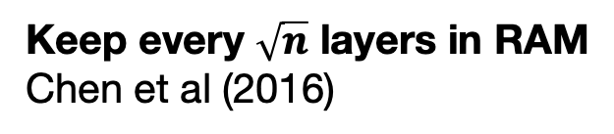
This work: trade-off RAM for compute, efficiently
RAM
Keep all layers in RAM
Keep every $\sqrt{n}$ layers in RAM
Chen et al (2016)
Checkmate explores optimal trade-off
5x larger models w/ 2x cost
Keep no layers in RAM
Compute
Notes:
More concretely, this work explores a tradeoff between memory and compute during deep learning. We’ll explore a few endpoints of this tradeoff space. Ultimately, Checkmate explores the optimal tradeoff between memory and CPU. We will show how Checkmate enables training 5x larger models.

Slide 8
RAM-hungry backpropagation policy
Keep all layers in RAM
RAM
Keep all layers in RAM
Keep every $\sqrt{n}$ layers in RAM
Chen et al (2016)
Keep no layers in RAM
Compute
Notes:
Let’s examine the current practice at one end of this tradeoff. Frameworks such as PyTorch and TensorFlow retain all activations in memory today.

Slide 9
RAM-hungry backpropagation policy
Keep all layers in RAM
RAM
used
Forward Pass
∇E
A
B
C
D
E
E
Label
D
Loss
∇A
∇B
∇C
∇D
∇E
C
Backward Pass
B
A
Time
Notes:
Deep learning is divided into two key phases, a forward pass and a backward pass. The backwards pass comptues gradients that iteratively optimize parameters. Let me demonstrate why the backwards pass is so memory intensive. Since we need to retain all activations, memory usage linearly increases during the forward pass.

Slide 10
RAM-hungry backpropagation policy
Keep all layers in RAM
RAM
used
Forward Pass
∇E
∇D
A
B
C
D
E
E
Label
E
D
Loss
∇A
∇B
∇C
∇D
∇E
C
Backward Pass
B
A
Time
Notes:
Finally, during the backward pass, we can free unused activations, but the peak memory usage is quite high.

Slide 11
RAM-hungry backpropagation policy
Keep all layers in RAM
RAM
used
Forward Pass
∇E
∇D
∇C
E
D
A
B
C
D
E
E
Label
D
Loss
∇A
∇B
∇C
∇D
∇E
C
Backward Pass
B
A
Time
Notes:
Finally, during the backward pass, we can free unused activations, but the peak memory usage is quite high.

Slide 12
RAM-hungry backpropagation policy
Keep all layers in RAM
RAM
used
Peak RAM
C
Forward Pass
∇E
∇D
∇C
∇B
∇A
D
A
B
C
D
E
E
B
Label
D
Loss
E
∇A
∇B
∇C
∇D
∇E
C
Backward Pass
B
A
Time
Notes:
Finally, during the backward pass, we can free unused activations, but the peak memory usage is quite high.

Slide 13
Compute-hungry backpropagation policy
Recompute all layers as needed, storing none
RAM
Keep all layers in RAM
Keep every $\sqrt{n}$ layers in RAM
Chen et al (2016)
Recompute all layers
Compute
Notes:
At the other end of this design spectrum we explore design point where we store as little data as possible in on-chip memory.

Slide 14
Compute-hungry backpropagation policy
Recompute all layers
RAM
used
Peak RAM (no recomputation)
Forward Pass
A
B
C
D
E
Label
D
Loss
∇A
∇B
∇C
∇D
∇E
C
Backward Pass
B
A
Time
How can we use less memory?
Free early & recompute
Notes:
So returning to our prior example, because we have begun to train and we realized we are going to run out of memory on the accelerator. How can we use less memory. One key insight is to free some nodes early. And then re compute some layers during the backwards pass.

Slide 15
Compute-hungry backpropagation policy
Recompute all layers
RAM
used
Peak RAM (no recomputation)
Forward Pass
A
B
C
D
E
Label
Loss
∇A
∇B
∇C
∇D
∇E
C
D
Backward Pass
B
B
A
C
A
Time
How can we use less memory?
Free early & recompute
Notes:
We free A, B, C.

Slide 16
Compute-hungry backpropagation policy
Recompute all layers
RAM
used
Peak RAM (no recomputation)
Forward Pass
A
B
C
D
E
Label
Loss
∇A
∇B
∇C
∇D
∇E
C
D
E
∇E
∇D
Backward Pass
B
B
A
C
A
Time
How can we use less memory?
Free early & recompute
Notes:
However, we cannot compute the gradient for C. We must recompute A, B and C during the backward pass.

Slide 17
Compute-hungry backpropagation policy
Recompute all layers
RAM
used
Peak RAM (no recomputation)
Forward Pass
A
B
C
D
E
Label
Loss
∇A
∇B
∇C
∇D
∇E
C
D
E
∇E
∇D
A
B
C
Backward Pass
B
B
A
C
A
Time
How can we use less memory?
Free early & recompute
Notes:
However, we cannot compute the gradient for C. We must recompute A, B and C during the backward pass.

Slide 18
Compute-hungry backpropagation policy
Recompute all layers
RAM
used
Peak RAM (no recomputation)
Forward Pass
A
B
C
D
E
Label
Peak RAM
Loss
∇A
∇B
∇C
∇D
∇E
C
D
E
∇E
∇D
A
B
C
∇C
…
Backward Pass
B
B
A
C
A
Time
How can we use less memory?
Free early & recompute
Notes:
This substantially reduces memory consumption, but at a great increase in runtime.

Slide 19
Prior heuristic as an intermediate trade-off point
RAM
Keep all layers in RAM
Keep every $\sqrt{n}$ layers in RAM
Chen et al (2016)
Recompute all layers
Compute
Notes:
There has been some prior work that has explored intermediate design points in this space time trade off, most notably Chen et al’s work in 2016 where they propose a simple heuristic of checkpointing every square root n’th node.

Slide 20
How to trade-off RAM for compute optimally?
Challenges:
RAM
1. Variable runtime per layer
Checkpoint
every node
2. Variable RAM usage per layer
Recompute all layers
3. Real DNNs are non-linear
Compute
Notes:
In our work, we want to answer the question of how to optimally trade off memory for compute during deep learning training. We design our solution to address three practical issues that have limited adoption of recomputation with real architectures.

Slide 21
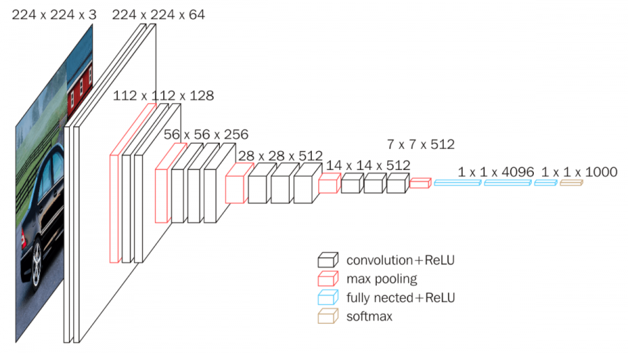
Why do fixed heuristics perform poorly?
Latency is not constant between layers
10⁶x compute gap between biggest and smallest layer in VGG19
x10⁶

Slide 22
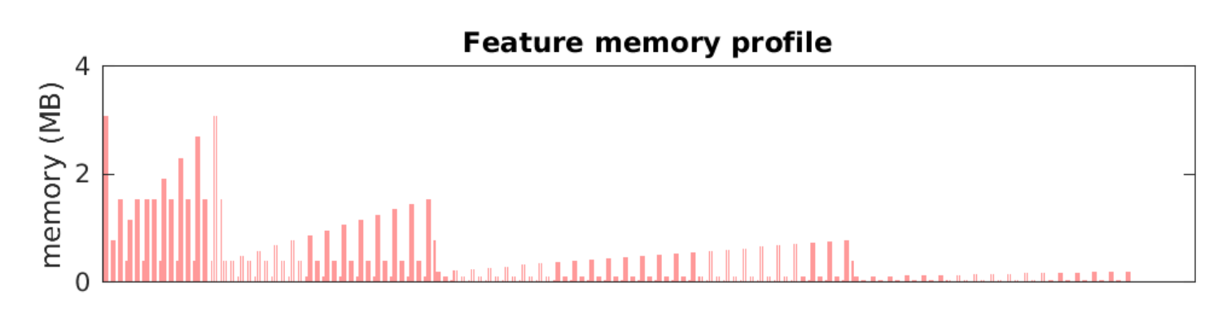
Why do fixed heuristics perform poorly?
2. Tensors are not all the same size
DenseNet-201 has large variability in activation sizes between layers
Feature memory profile
4 MB
x10³
2 MB
0 MB
Operation
Data from https://github.com/albanie/convnet-burden/blob/master/reports/densenet201.md

Slide 23
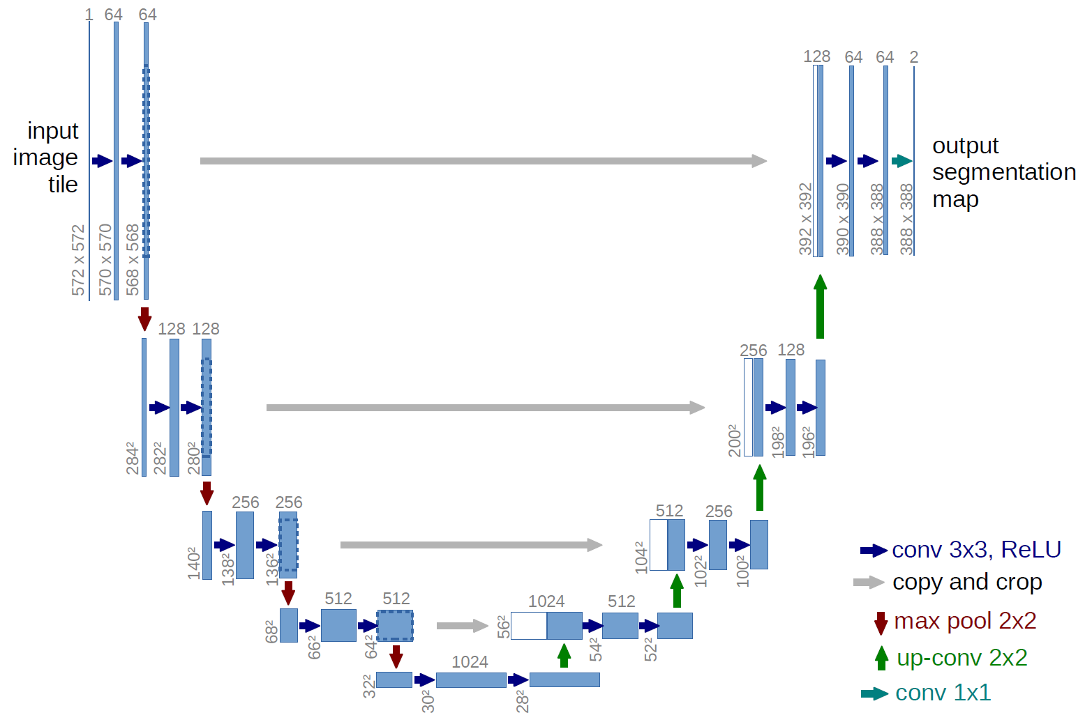
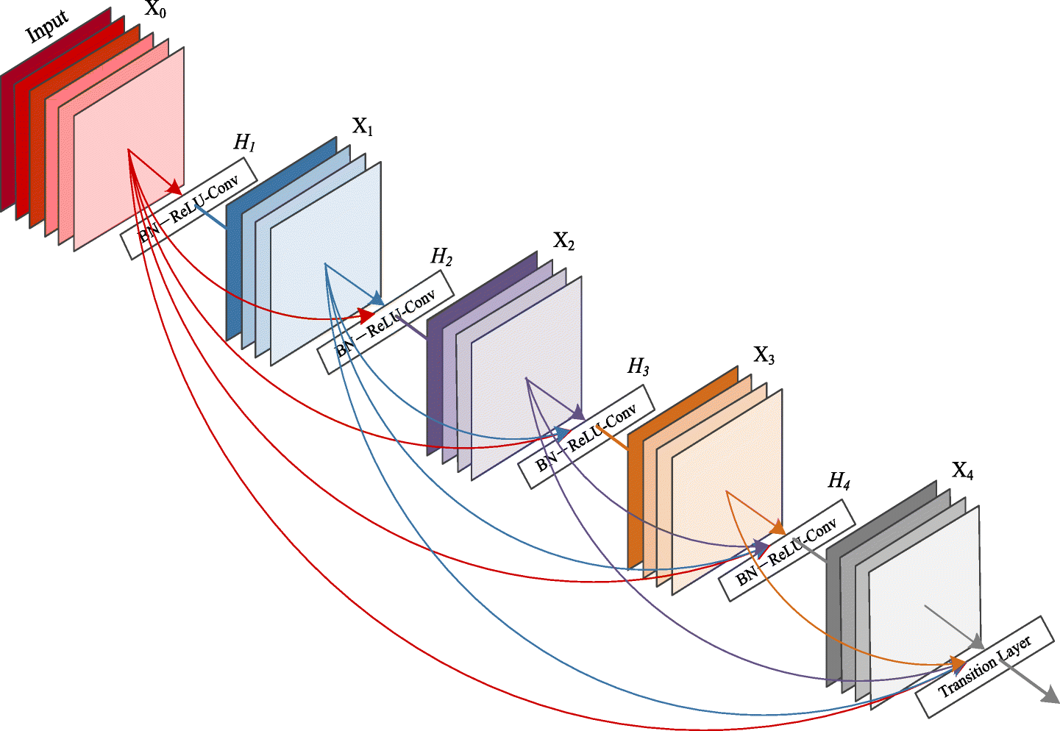
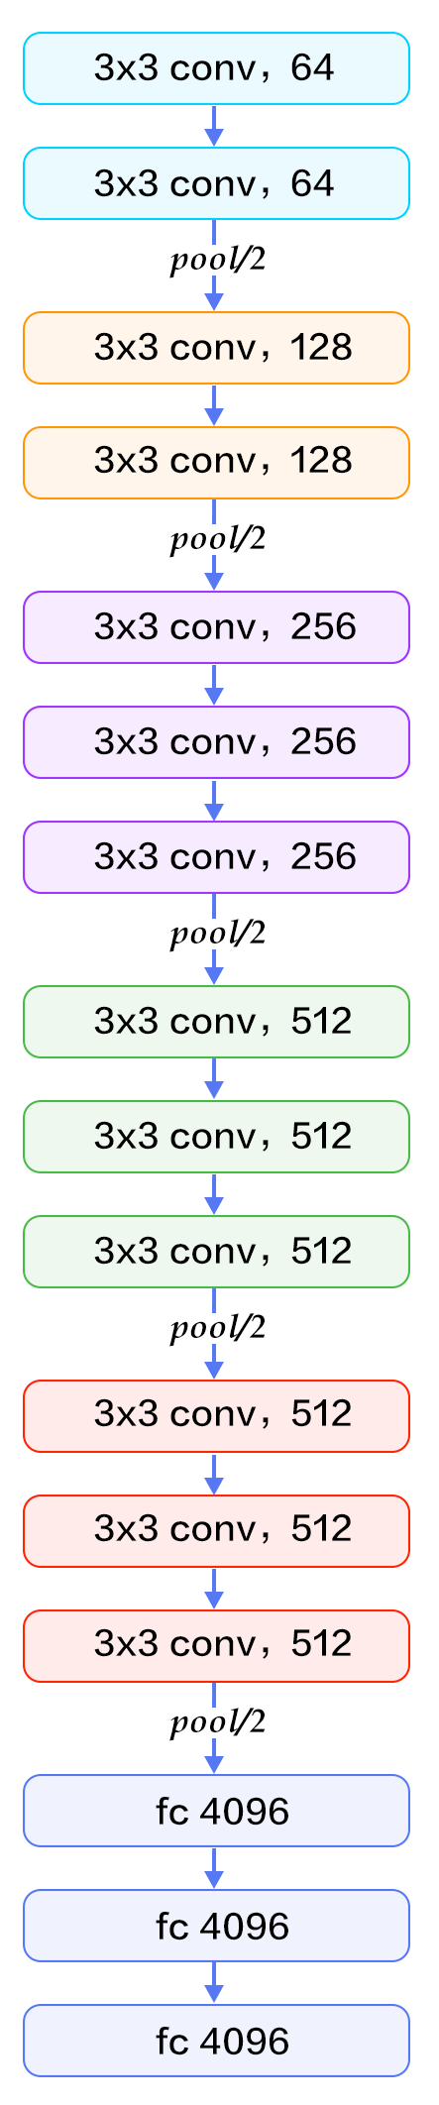
Why do fixed heuristics perform poorly?
3. Real DNN architectures are non-linear
U-Net: 11k citations
DenseNet: 7k citations

Slide 24

A system for optimal tensor rematerialization
Profile layers
Statically optimize graph once (10s to 1hr)
Train optimized graph for weeks
Checkmate composed of 3 parts:
  Profiling: hardware/RAM aware schedules
  Integer LP: enables finding optimal schedule
  TF2.0 graph pass: support TPU, GPU, CPU
Solve integer LP
Rewrite TF2.0 graph
Notes:
In light of these challenges, we propose Checkmate, a system for optimal tensor rematerialization. Checkmate optimizes a graph statically once. This optimization is then amortized across many iterative training iterations over the span of weeks. Checkmate consists of three main parts:. We will focus on the second optimization phase in today’s talk. Please come to our poster tonight for more details.

Slide 25
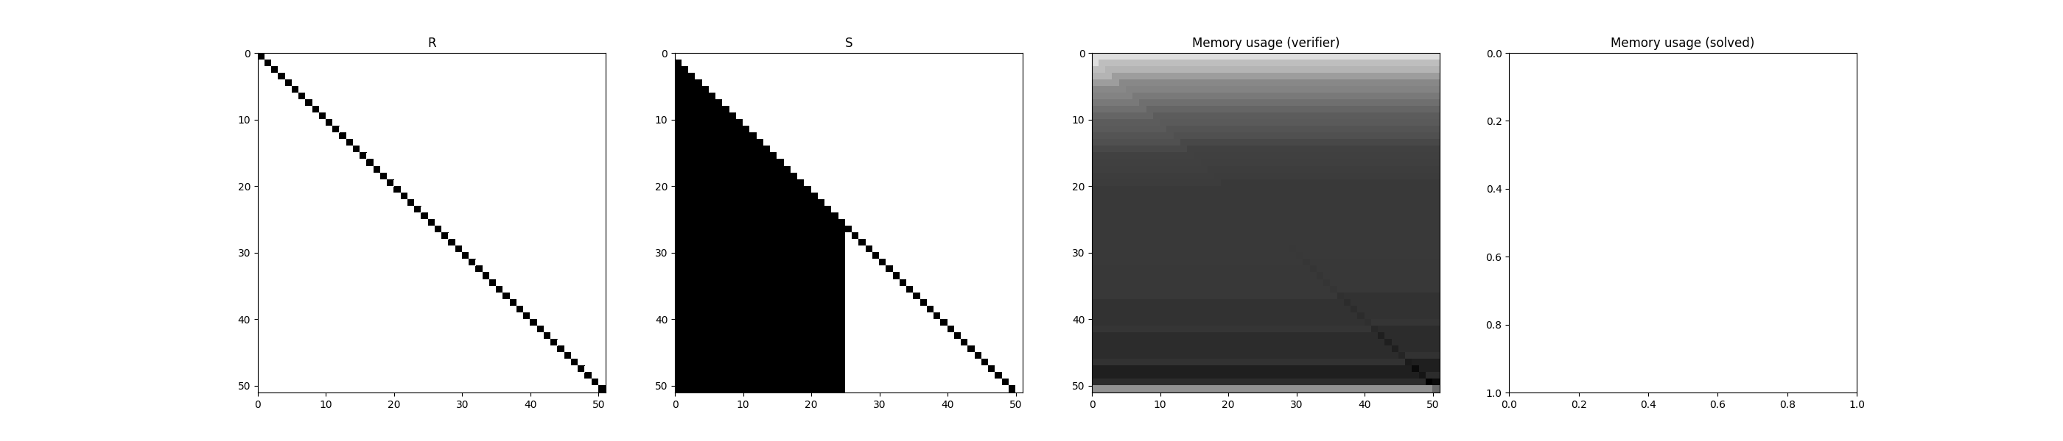
Concrete example: VGG19
224x224 images
What is computed?
What is in memory?
Checkpointing all nodes:
Batch size 167
When?
Notes:
Let's investigate the VGG classification architecture. The current practice checkpoints all nodes in the graph. The net result of this is that the maximum batch size feasible on a V100 is just 167. We represent two sets of decision variables; (1) what is in memory and (2) what is computed. We unroll these two vectors over several timesteps which enables time-varying checkpoint allocations. When checkpointing all nodes, the forward pass nodes in the left half of the right matrix are retained for the duration of the training iteration.

Slide 26
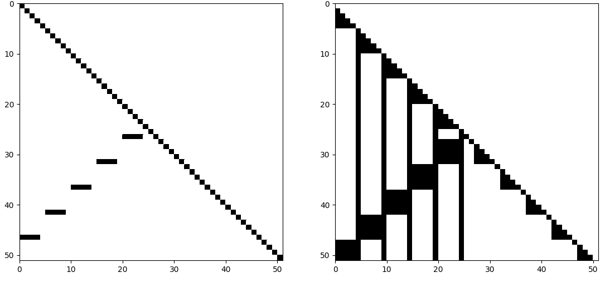
Concrete example: VGG19
224x224 images
What is computed?
What is in memory?
When?
Square root heuristic
Batch size 197
1.18x larger!
Notes:
We can look at the common heuristic, that is the square root and heuristic of Chen at all. and here we can see that it takes regular checkpoints at square root and intervals. And the net result of this is that it has to recompute server nodes. During the backwards pass as shown in the left hand side matrix. The result of general solution is that it improves the batch size to 197, that is an 18% improvement over tensor flows default policy.

Slide 27
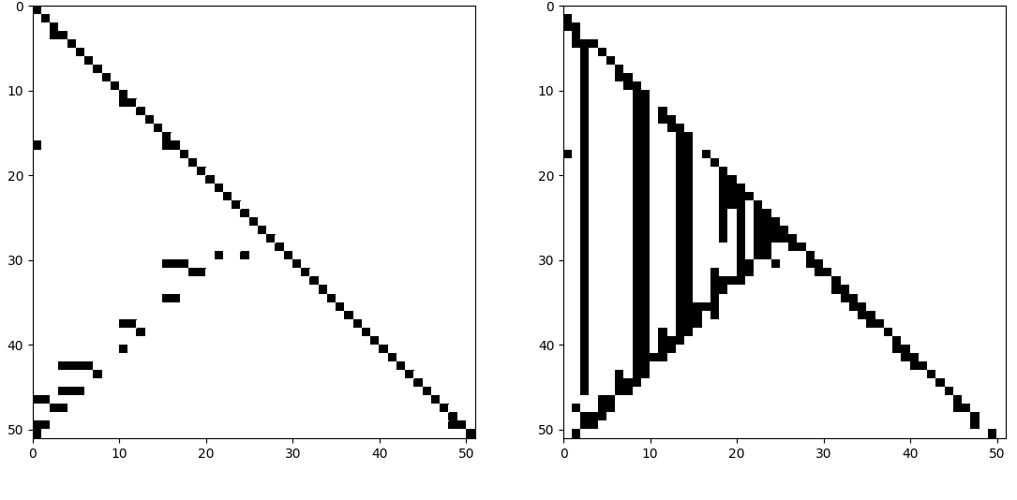
Concrete example: VGG19
224x224 images
What is computed?
What is in memory?
When?
Checkmate
Batch size 289
1.73x larger!
10 second solve time
Notes:
However, the optimal policy can achieve a bad size of 289, and this represents a 73% improvement over the baseline. So this is a dramatic improvement over current solutions. And as we can see in the schedule, there is a high amount of dynamic variability between what is in memory between layers. Certain layers are memory-hungry yet expensive to recompute and therefore are always cached.

Slide 28
Evaluation: Checkmate supports complex models (U-Net)
Best heuristic
Checkmate
GPU Memory available (GB)
Notes:
We can also evaluate checkmate on highly nonlinear models. Here, we investigate U-Net, a network with many skip connections across resolutions. We specifically evaluate the space-time tradeoff for the best baselines, as compared to checkmate. The best heuristic does achieve a tradeoff between compute overhead and memory usage, up to 30% computer overhead and available GPU memory. However, across all budgets checkmate finds dramatically lower overhead solutions. Also, checkmate find solutions that are feasible at smaller amounts of GPU memory than the baselines.

Slide 29
Evaluation: Checkmate enables training w/ large inputs
5x larger input size
MobileNet
Best heuristic
Checkmate
GPU Memory available (GB)
Notes:
We also evaluate Checkmate on a variety of other models, including MobileNet a popular edge computing model for image classification. And again, we can see that checkmate accomplishes significantly more optimal solutions the best available heuristic. What this means in practice for machine learning researchers, is that they can, in effect, train their models with up to five times larger input sizes than currently possible with deep learning frameworks today.
Rename budget as RAM available
Flip order of best heuristic and my solution
Remove shaded blue region
Paste in “Checkpoint all” and “Checkpoint none”
Align colors
Label legend boxes

Slide 30

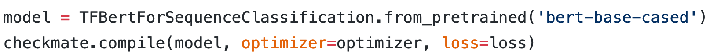
Code and paper:
checkmateai.github.io
Email me:
parasj@berkeley.edu
Key ideas:
GPU memory limits are preventing the development of new deep learning models.
We present the first general solution for optimal graph recomputation.
Formulation supports arbitrary DAGs and is both hardware-aware and memory-aware
Integration with just one line of code
Notes:
Checkmate breaks memory wall, enabling you to not worry about memory constraints. Build bigger models.
Today, I presented Checkmate, a system that prevents out-of-memory errors when training large neural networks via optimal recomputation.
If you have a memory-hungry deep learning workload, please email me! Our code is now online at Github.

